Slide 1

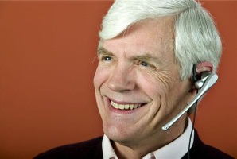
Simplified,
hands free
[http://t1.thpservices.com/fotos/thum4/015/676/esy-000747668.jpg]
web browsing
for the elderly.
[http://pictures.directnews.co.uk/liveimages/Older+man+on+headset_959_18380302_0_0_7005776_300.jpg]
=Voice-controlled web browsing for the elderly =

